Slide 1
EDUCATION IN THE UK AND ITALY
ALUNNE:
-Giulia Pandolfo
-Sara Lo Verso
-Sofia Pellitteri

Slide 2
THE EDUCATION SYSTEM IN THE UK
Nursery school : this is not compulsory, and ranging from 3/5.
Primary school : this is compulsory, and rancing from 5/11.
Secondary School : this is compulsory, and rancing from 11/16
A-Level : this is ADVANCED level of study of the English system preuvious University, the duration of the course is two years.

Slide 3
SCHOOL

Slide 5
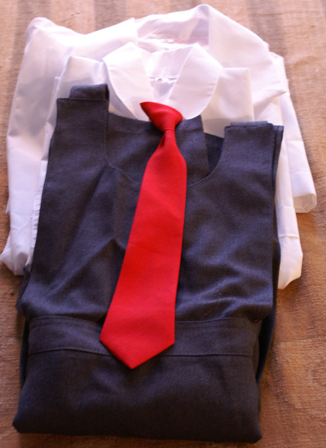
THE UNIFORMS They are compulsory in the UK school:
Boy : jacket , pants , shirt , tie.
Girls : skirt , jacket , shirt.

Slide 6
SCHOOL LIFE
The school day : the first lesson begins at 9.15 a.m. and classes end at 3.30 p.m. every day. Classes saturdays are very unusual. Sport is an important part of school life. It is compulsory.
Typically boys play football in winter and cricket in spring; an girls usually do aerobics or play netball.
Nowadays teachers can punish their students with lines or detention, with means that students have to stay after school .

Slide 7
The differentes between the school in the UK and in italy
Education in the UK | Education in Italy
Wear uniforms | Don’t wear uniforms
Less subjects | More subjects
Starts at 9:00 o’clock | Starts 8:00 o’clock
Finish at 15:00 p.m | Finish at 14:00 p.m
The punish is stay after school. | The punish are notes.
The assembly is once a week, before starting lessons. | The assembly is once a month, all day

Slide 8
NEGATIVE POSITIVE
In the UK, short childhood. | In the UK, there is good a large choise of subjects.
2. In the UK, the school is very strict. | 2. In the UK, there is a big percentual of students.
3. In the UK, wear uniforms. | 3. In the UK, the lessons start at 9:00 o’clock.
4. In the UK, the assembly is once a week, before starting lessons. | 4. In the UK, they have a lot of holidays.

